Slide 1
إدارة المشروعات
Projects Management
د. باسم ممدوح الحلوانى

Slide 2
Course Info.
Title | Projects Management
Lecturer | Dr. Basem ElHalawany
Teaching Assistance (TA) | N/A
Grades | 50
Final Exam Grades | 40

Slide 3

Course References
Information Technology Project Management, Kathy Schwalbe, 7th Edition.
Project Management Handbook, Wouter Baars, Version 1.1
A Guide to the Project Management Body of Knowledge (PMBOK Guide), 5th Edition (Arabic and English versions).
Global Feasibility Study For Engineering Projects, A. H. Gomaa, AUC.
Engineering Project Management, Nigel Smith, 2nd Edition, University of Leeds.
Using
Arabic or English
is permitted

Slide 4
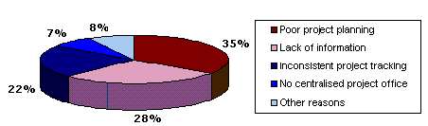

Introduction
نسبة كبيرة جدا من أسباب فشل المشروعات تكون متعلقة بسوء أو عدم وجود إدارة مشروعات
تبين من الدراسات أن:

Slide 5
Why we should learn Project Management ?
Project Management has become one of life skills
For your career (there is a huge gap between supply and demand for project managers)
Surveys has ranked Project management among the top 3 skills most wanted by employers (along with leadership and business analysis).
Organizations needs project management for many reasons such as improving customers service, decrease costs, and better management of time.

Slide 6
Top Ten Most In-Demand IT Skills

Slide 7
Introduction to Project Management
Project:
A Project is a Creation of Business Value
A Project is a group of (milestones/phases/activities or tasks) that support an effort to accomplish something
A Project is a unique & temporary effort with a defined beginning and end, undertaken to meet specific goals and objectives, typically to bring about beneficial change/added value/create product or service, including the constraints of time, cost, scope, and quality.
هو جهود تبذل بصفة مؤقتة لإخراج منتج أو خدمة أو نتيجة فريدة من نوعها ويخضع لمجموعة من القيود.

Slide 8
Why a project emerges?
لماذا ينشأ المشروع
A Market Demand:
Ex. Oil company want to build oil refinery
A Customer Request :
Ex. Power company authorize a new power plant
A Technological Demand:
Ex. New video game
A Legal requirement :
Ex. Toxic Waste Disposal Center

Slide 9
Project Characteristics
خصائص المشروع
Project is Temporary
Definite beginning
Definite end: When objectives achieved, or When Objectives cannot be met (terminated)
Project is Unique
Never happened before & will never happen again under the same conditions.
No two projects are precisely alike (Some elements are unique)
حتى لو تشابهت الأنشطة نجد الاختلاف في المالك الأفراد المكان البيئة وغيرها
Done for a purpose (i.e. Creates a unique product, service)
Progressive elaboration:
يخضع للتطوير المستمر كلما توفر مزيد من المعلومات
Has interrelated activities
Subject to constraints .

Slide 10
Project Characteristics
خصائص المشروع
Requires resources, often from various areas.
Should have a primary customer or sponsor.
    The project sponsor usually provides the direction and funding for the project.
  Involves uncertainty and risks.

Slide 11
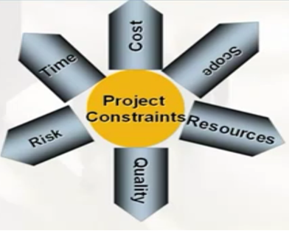
Project Constrains
القيود المفروضة على المشروع
As a Project Manager you should keep balance between these constraints.
When one element change, you should consider changes in other elements
  Scope : What work will be done?
  Time : How long should it take to complete?
  Cost : What should it cost?

Slide 12
ما الفرق بين المشروع والعمليات اليومية؟
العمليات اليومية
المشاريع
الخصائص
  انشطة مستمرة
  منتجات أو خدمات متكررة أو متشابهة
  الأعمال المعتادة للمؤسسة
الخصائص
  مؤقتة - ذات بداية ونهاية
  منتج أو خدمة فريدة
  لا تمثل جزءاً من العمليات اليومية للمؤسسة
أمثلة
  خط تجميع بمصنع سيارات
  عملية إصدار فواتير لشركة بطاقات إئتمان
أمثلة
  تصميم برنامج جديد
  إنشاء مبنى

Slide 13
Classification of Project Types
Education | Schools, colleges
Public Safety | Police, fire, National guard
Recreation | Parks, playgrounds, historic sites
Development | Harbors, dams, irrigation,
Scientific Research | Engineering, Health, space, Agriculture, Medical, etc
Defense | Military equipment and systems
Conservation | Forests, shorelines, pollution
Transportation | Highways, mass transit, airports
Utilities | Electric power, gas, telephones

Slide 14
Project Stake-holders
أصحاب المصلحة
Individuals and Organizations - actively involved in the project, whose interest may be affected as a result of project execution
OWNERS & SPONSORS
SUPPLIERS
THE PROJECT
CUSTOMERS
  Opponents
Project Manager
&
SOCIETY
Project Management Team
EMPLOYEES

Slide 15

Project Failure
فشل المشروع
المشروع الناجح:
هو الذي ينتهي بعد تحقيق متطلباته وفقا لـــ:
فشل المشاريع:
يعتبر المشروع بأنه فاشل في أحد الحالات التالية:
إذا تأخر عن موعد التسليم
إذا تجاوز الميزانية
إذا لم ينل رضى العميل
إذا لم يحقق أهدافه
إذا كانت الجودة سيئة
الوقت المحدد (Time)
التكلفة المحددة (Cost)
النطاق المحدد (Scope)
الجودة المطلوبة (Quality)
النطاق المحدد
الوقت المحدد
التكلفة المحددة
الجودة المطلوبة

Slide 16
Project Failure
فشل المشروع
Example in IT projects (a terrible track record):
  A 1995 Standish Group study (CHAOS) found that only 16.2 percent of IT projects were successful in meeting scope, time, and cost goals.
  Over 31 percent of IT projects were canceled before completion, costing over $81 billion in the U.S. alone. [1]
[1] The Standish Group, “The CHAOS Report” (www.standishgroup.com) (1995). Another reference is Johnson, Jim, “CHAOS: The Dollar Drain of IT Project Failures,” Application Development Trends (January 1995).
النطاق المحدد
الوقت المحدد
التكلفة المحددة
الجودة المطلوبة

Slide 17
Project Success Factors
Experienced project manager for proper planning
Clear business objectives
Minimized scope
Firm basic requirements
Reliable estimates
small milestones

Slide 18
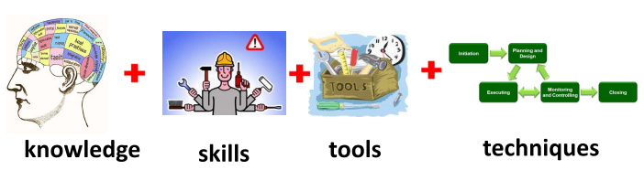
Project Management (PM)
PM Institute (PMI) Definition
PM can be defines as the application of knowledge, skills, tools and techniques to project activities to meet project requirements.
تطبيق المعارف والمهارات والأدوات والتقنيات في جميع أنشطة المشروع ليحقق متطلباته

Slide 19
Project Management (PM)
Other Definitions:
PM is the complete set of tasks, techniques, and tools, applied during Project Execution.
PM is the planning, monitoring and control of all aspects of the project. AND the motivation of all those involved (Stakeholders) in it to achieve the project objectives on time and cost, quality and performance.

Slide 20
Example of Project Management
PM can be applied to any project regardless of size, budget or timeline.
Some examples are:
  Developing a new product or service
  Running a political campaign
  Designing a communication system
  Designing a Software developing project
  Negotiating an agreement
  Setting up an e-commerce internet site
Notes:
note that only one part of my current project has a technology component to it – the majority of the work involved will be business changes!

